Slide 1
SAIX Journey in re-shaping the Saudi ecosystem

Slide 2
An overview of the ecosystem
01
02
SAIX Introduction
Agenda
03
Collaboration Models
04
Summary of the journey
05
Key results

Slide 3
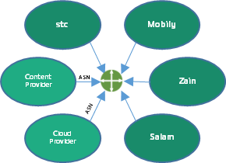
Digital Infrastructure Ecosystem components
International connectivity
Data Center/ Hosting
Peering
National and access connectivity
(Eyeballs)
Transport network
Submarine cable
International landing stations
Home
Enterprises
The absence of a neutral IXP would have an impact on
Resiliency
Economics
Attractiveness
User Experience
The need to have a direct interconnection between services providers
Significant % of traffic is international1, resulting in high overall transit costs
Unattractive internet ecosystem due to the lack of neutral digital infrastructure
Network traffic is following suboptimal paths

Slide 4
Introduction
SAIX
A neutral non-profit Internet Exchange Point which can enable the development of ICT services and the Internet ecosystem, by offering a world-class service for all networks to connect and peer, which can reduce cost, enhance performance, enable content localization, and improve investments.
GOALS
SAIX was lunched in 2018 as a collaboration between
Localize internet traffic and internet services
Initiative Stakeholders
Improve quality and sustainability
Enabling Members
Become a Digital Hub

Slide 5
Our working principles
Neutrality
Fairness
Quality
Collaboration
Providing the peering services independently of other connectivity services
Maintain a level playing field that allows every operator to provide their services
Develop Internet performance visibility tools.
E.g. (looking-glass, Reports)
Activating the role of members.
Active participation in the global events
Awareness Sessions

Slide 6
Collaboration Models

Slide 7
Integrating with stakeholders
1
2
Phase#2: Activating the participation from stakeholders
Role and Responsibilities
Phase#1: Starting the Initiative
Steering Council
Approval on strategy & planning for IX
Approval for Policies and Governance
Manage regulatory interaction
MCIT is the
owner of IXP
Members Council
Revise IXP Strategy
Develop expansion requirements & plans
Vote for Agreement, technical, or strategy change
cst supports to establish effective regulatory environment
KACST host &
operate of the IXP
Operators are members
and enablers
IX Management
Handling daily operations, reports, and ensuring compliance
Attracting members and platforms to be localized and exchanged through SAIX
IXP market nascent – required intervention
Multiple committees/ councils have been launched to enable and maintain the working principles
2018
2019 - 2023

Slide 8
SAIX has adopted two connection models
Managed Connection
Collocated Member
A potential member could plan (or have) a presence in a remote datacenter and can arrange through one of the enabling members to get a connection to SAIX.
SAIX
A Potential member can collocate his network within the facility that the SAIX is located, and arrange to get a back to back connection to SAIX to peer with others.
Transmission through enabling Members (FBP)

Slide 9
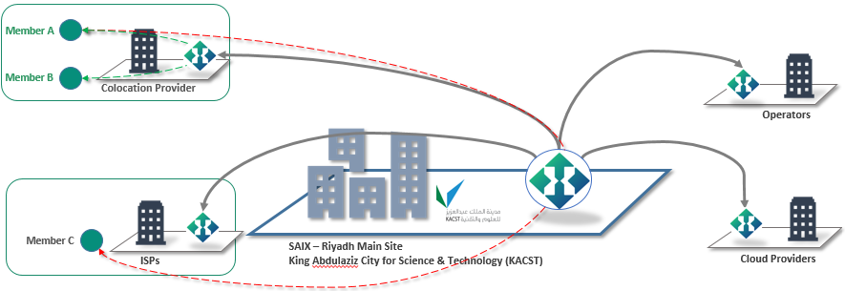
Expansion footprint through existing facilities
- Certified exchange facility (CxF) Program
Activating the role of enabling members to utilize existing investment in Facilities and Data Centers, and emphasizing on neutrality within operators’ facilities enabling an easy way for getting SAIX peering service

Slide 10
What has been achieved!

Slide 11
Historical figures
2019
2021
2022
Traffic
The adoption of digital services in the region
28
100
160
Members
The development of ecosystem and sustainability of services
6
12
19
ASNs
organizations that utilizes public services
124
136
172
Capacity
Ports connected to SAIX
140
^{Gbps}
450
^{Gbps}
1.1
^{Tbps}
Prevent
Promote
Protect
Coordinate
Tools
MANRS

Slide 12
Current readings
179 ASNs
+25K IPv4/ v6
Prefixes
2
Tbps
Connected
99%
Visibility on Saudi addresses
100%
Uptime
23
Members

Slide 13
Summary of the Journey
2018
2019
2020
2021
360 Gbps
PEAK
TRAFFIC
2022
2023
100 Gbps
PEEK
TRAFFIC

Slide 14
Key Results
+80% enhancement in the latency to services/ content connected to SAIX
Resiliency
6 DNS root servers
MANRS participant
X10 national capacity
The joint efforts and collaborative work has a clear impact on the following areas
Economics
~$30M Savings on the international connectivity
Attractiveness
+160MW in DC
20 CDNs, CDP, SP
User
Experience
+80% enhancement in the latency to services/ content connected to SAIX

Slide 15
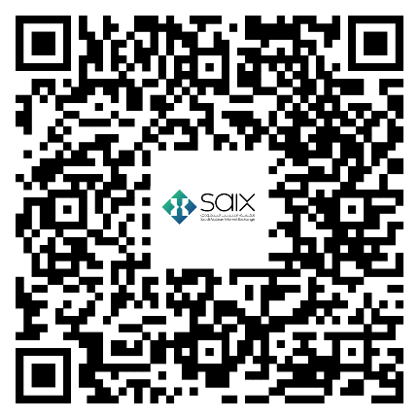
support@saix.sa
Saix.sa
المقسم.السعودية
SAIX Overview
Thank You!

